Slide 1
Making hybrid images
Pavel Khrulev

Slide 2
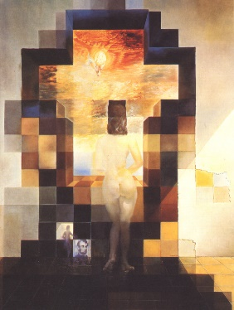
Retrospect
Artists could make “hybrid images” many years ago.
No science, no mathematics, no programming.
Just imagination and magic brushstrokes.
Gala Contemplating the Mediterranean Sea (Salvador Dali)

Slide 3
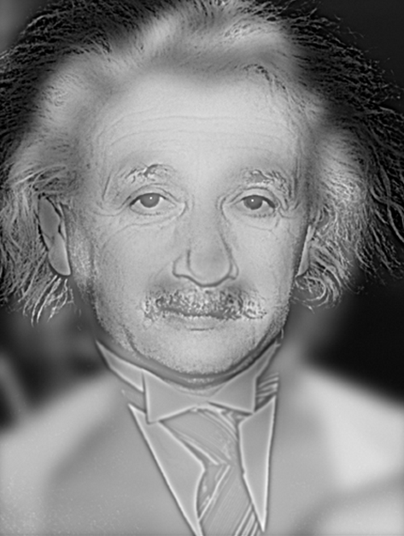
Retrospect
In 2006 Aude Oliva, Antonio Torralba, and Philippe. G. Schyns merged the distance of Dali and the faded smiles of da Vinci into one interesting idea.
The most famous hybrid image based on that idea is Marylin Einstein.
Marylin Einstein

Slide 4
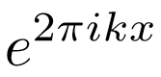
Methodology
A hybrid image is obtained by combining two images, one ﬁltered with a low-pass ﬁlter and the second one ﬁltered with a high-pass ﬁlter.
Filters based on the idea of Fourier analysis.
An image in frequency domain is a linear combination of Fourier coeﬃcients:
The main problem is to find the proper cut-off frecuency.

Slide 5
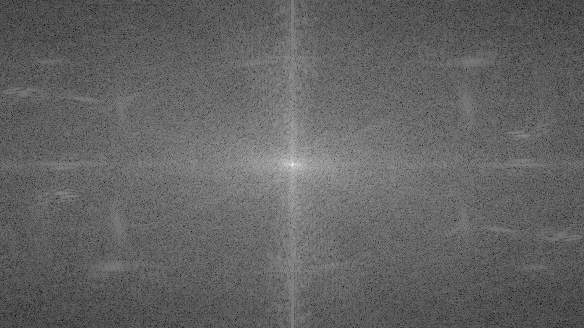
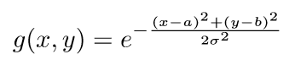
Methodology
Each dot in this grid corresponds to how intense the Fourier coeﬃcient is.
Closer to the origin - the smooth changes in the image.
Further away from the origin - sharp changes and edges.
Image in frequency domain
For getting only low or high image frequencies, it needs to use the Gaussian ﬁlter:

Slide 6
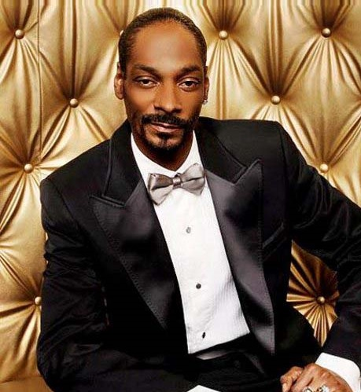
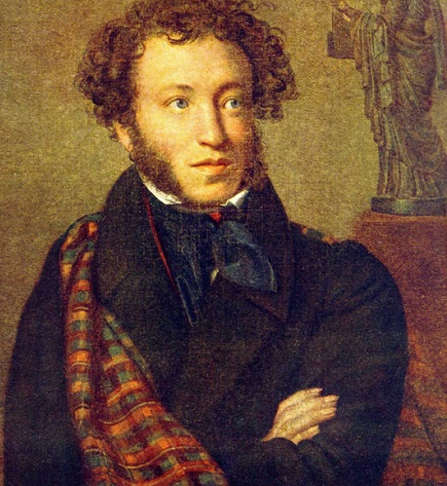
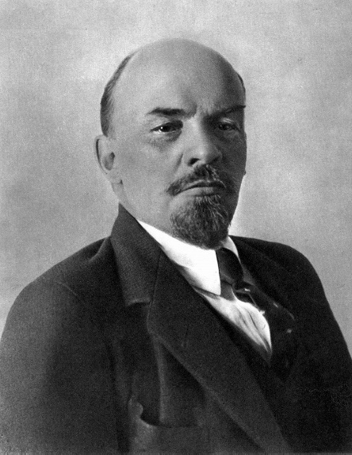
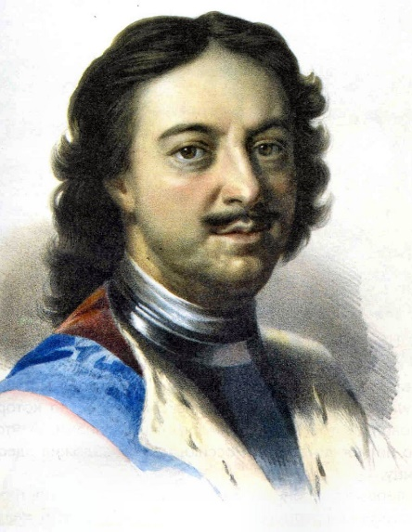
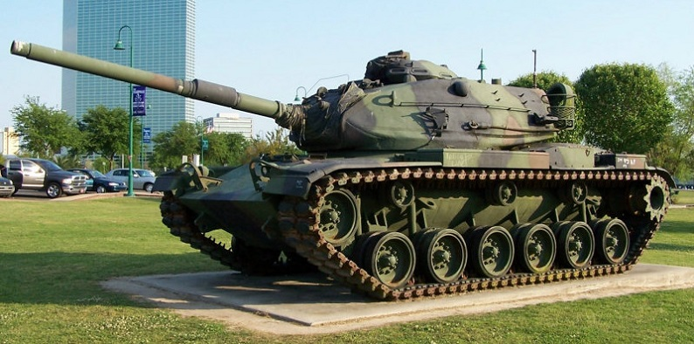
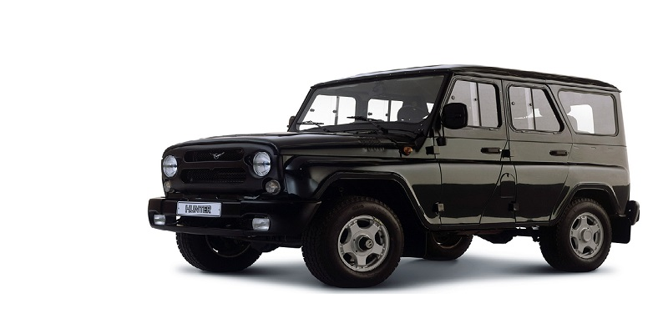
Image sets
Set 3
Set 2
Set 1

Slide 7
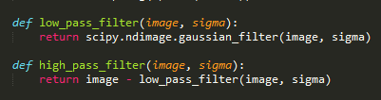
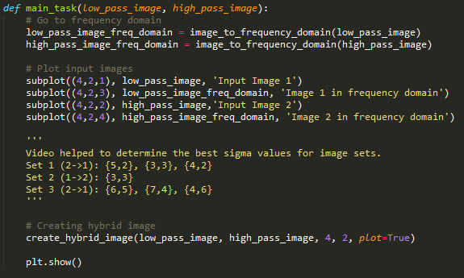
Hybrid image creating
For image filtering SciPy library is used.

Slide 8
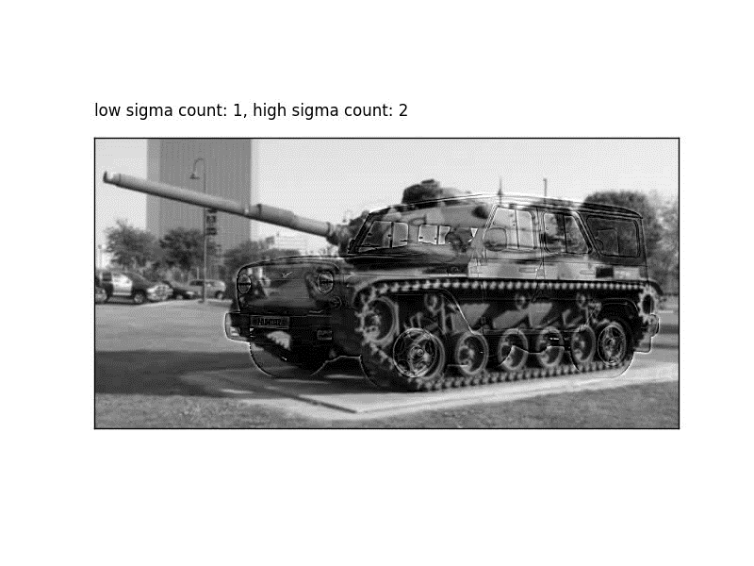
Helper video

Slide 9
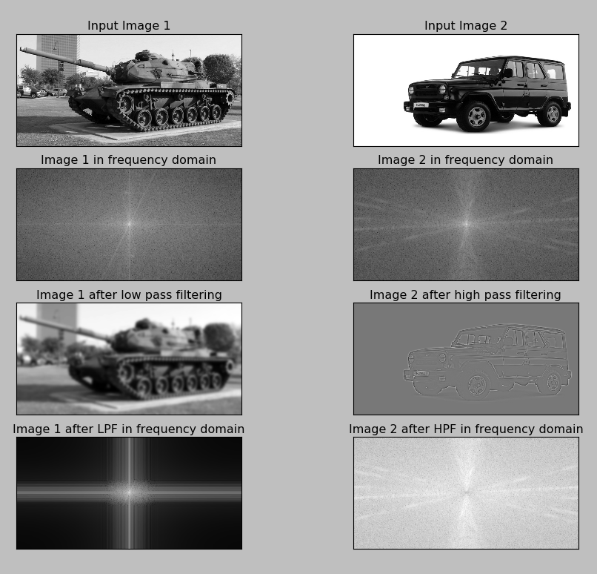
Hybrid image selection
Helper images

Slide 10
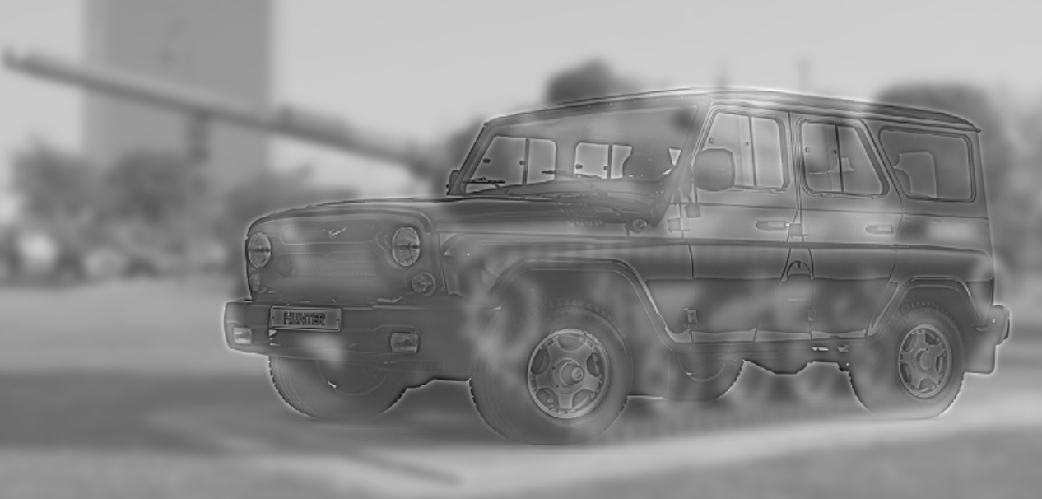
Hybrid image selection
Set 1: obtained hybrid image
Close-up view: off-road car
Far-away view: tank

Slide 11
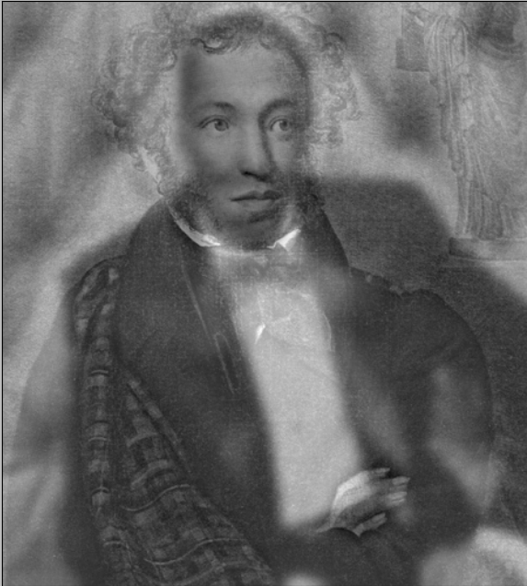
Hybrid image selection
Image with Snoop Dogg has many details on background.
It’s hard to blur it properly without color correction.
The correct way to solve this problem is to swap images.
Set 2: bad image

Slide 12
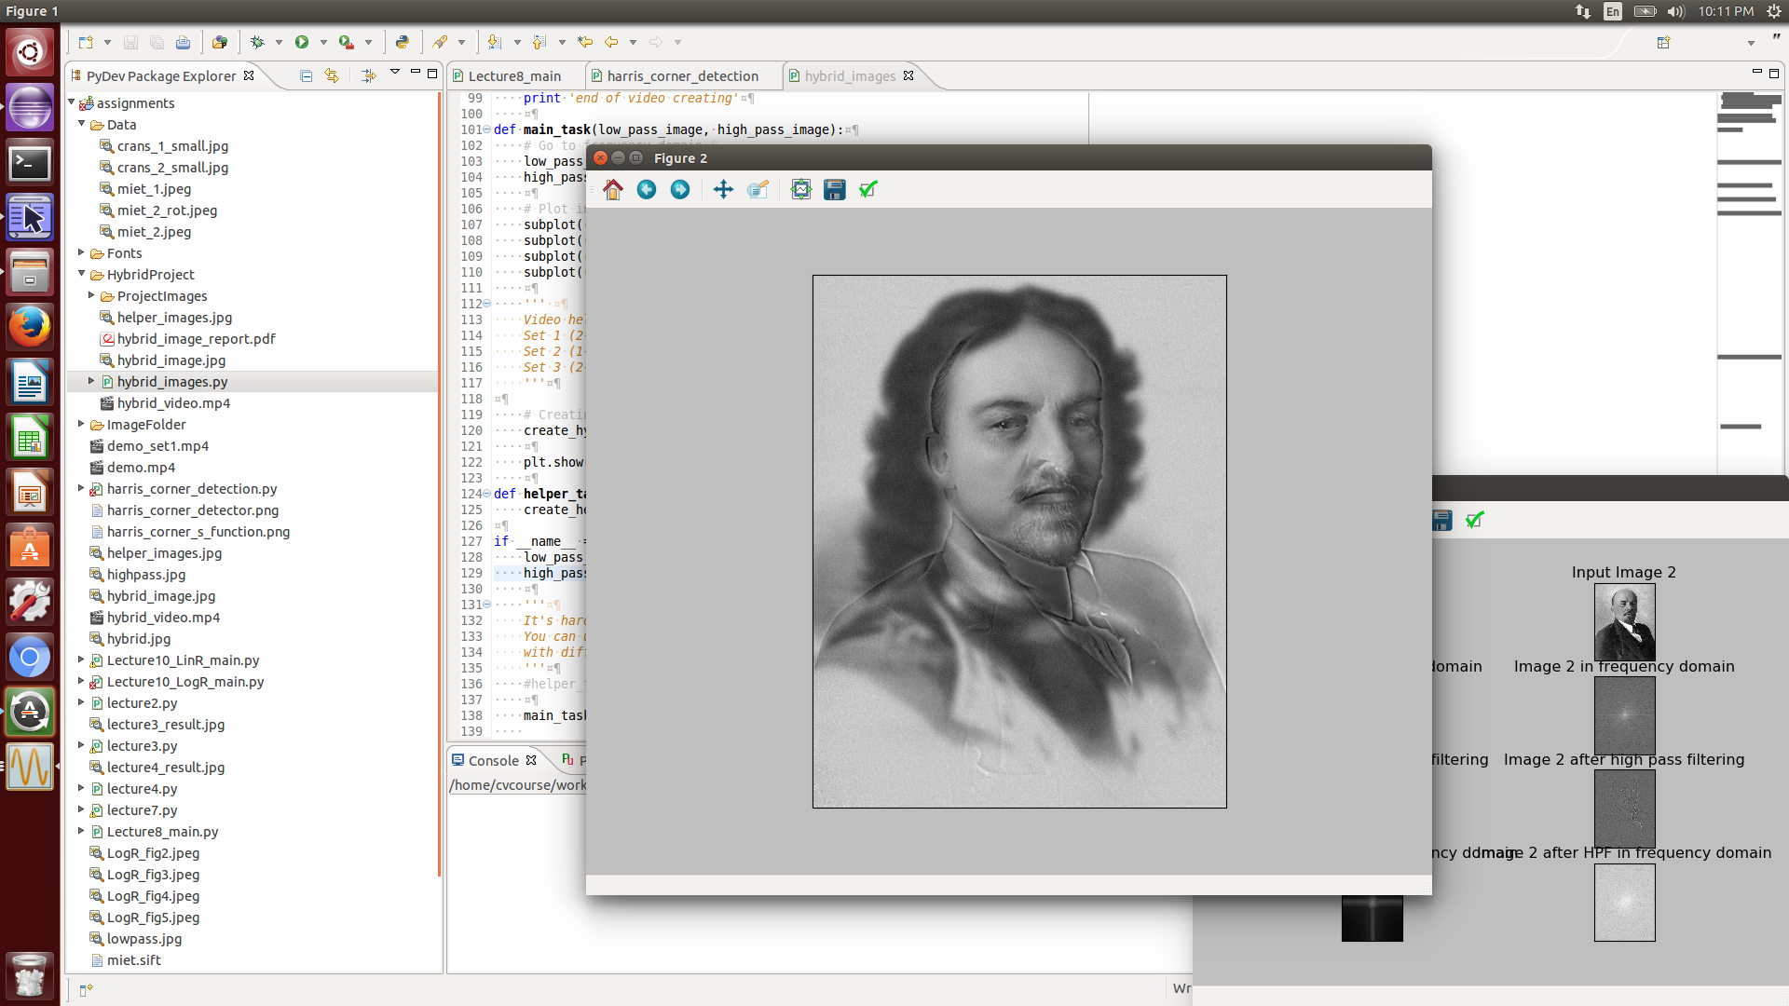
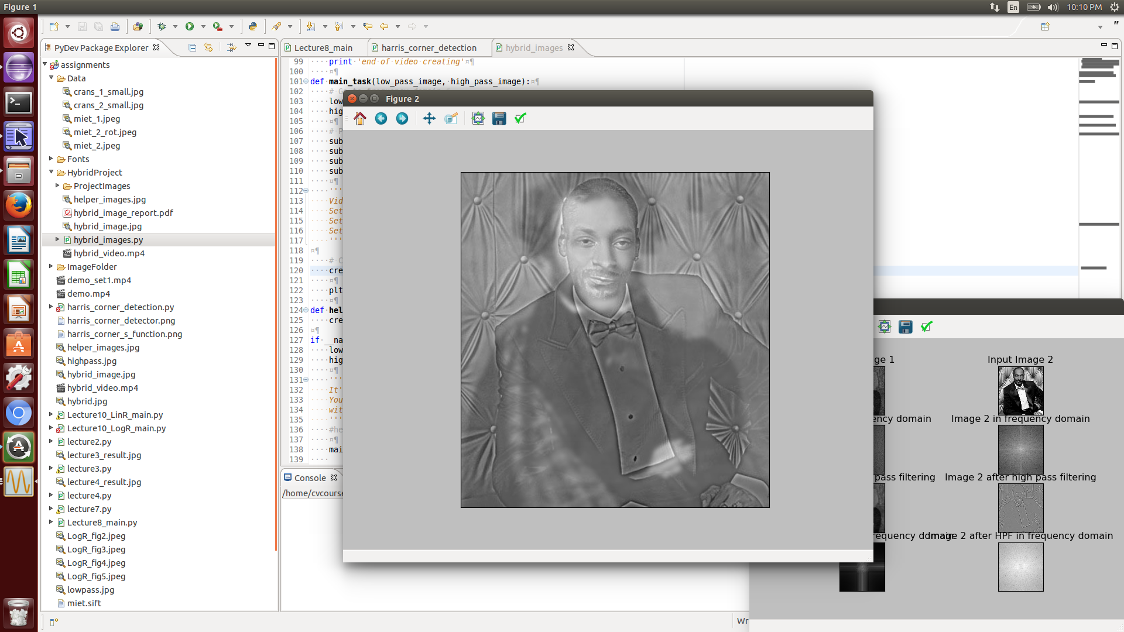
Results
Set 2: obtained hybrid image
Set 3: obtained hybrid image

